Slide 1
MCA Final Year Project (Review I)
E-SAHAKARA (Initialization and configuration, General Ledger & Financial Statements)
Submitted to the Presidency University, Bengaluru in partial fulfillment for the award of the degree of Master of Computer Applications(MCA)
Project Number : MCA_PR218
Ass
Under the supervision of
Mr. S. Shakthi
Asst. Prof of SCSE
Name | Roll Number
Shubhan G C | 20232MCA0194

Slide 2
Content
Problem Statement
Literature Survey
Screenshot
References

Slide 3
Problem Statement
Lack of Standardized Setup - Cooperative societies struggle with inconsistent system configurations, leading to operational inefficiencies and compliance issues.
Data Validation Issues – The absence of automated validation mechanisms results in inaccurate member and financial records, impacting decision-making
Inaccurate Financial Tracking – Manual bookkeeping leads to errors in transaction records, affecting financial integrity and decision-making.
Audit and Reporting Challenges – The absence of structured audit trails makes financial verification and reporting cumbersome, increasing the risk of discrepancies.

Slide 4
Literature Review
Sl No. | Title of Paper | Year | Methodology Used | Challenges Faced | Advantages | Disadvantages
1 | System Initialization and Role-Based Access Control in Financial Platforms | 2023 | Automated system setup, role-based access control (RBAC) implementation | Security vulnerabilities in manual configuration, lack of user access restrictions | Enhances security, reduces manual errors, ensures compliance | Implementation complexity for non-technical users
2 | Automated Financial Management and General Ledger Systems in Cooperative Societies | 2022 | Financial tracking, reconciliation, and compliance-integrated reporting | Difficulty in integrating automation with legacy systems | Improves accuracy, efficiency, and decision-making | High initial cost of implementation
3 | Gaps in Financial Customization for Cooperatives: A Study on Existing Solutions | 2024 | Comparative analysis of existing financial software and customization needs | Lack of tailored solutions for cooperative accounting | Highlights the need for an integrated and customizable financial system | Limited real-world case studies on cooperative-specific financial models

Slide 5

Screenshots
Login Page

Slide 6
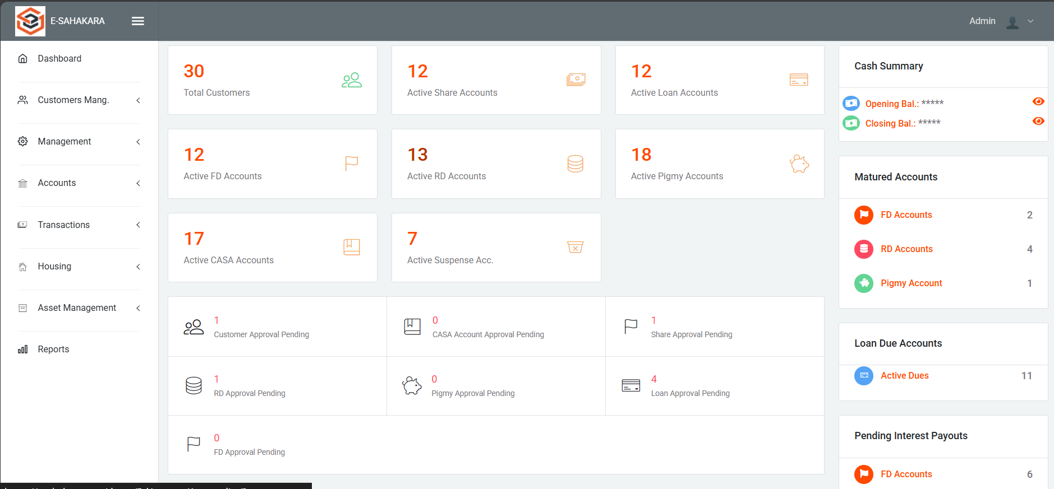
Dashboard

Slide 7
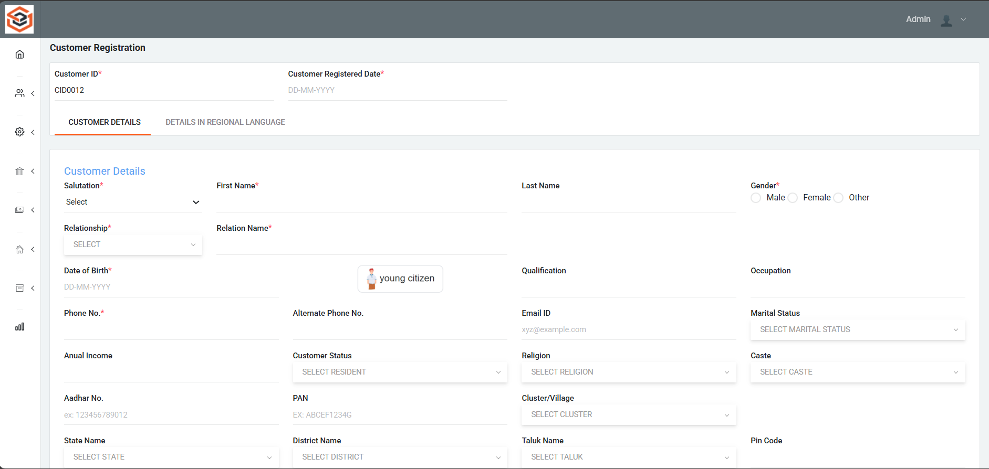
Customer registration page

Slide 8
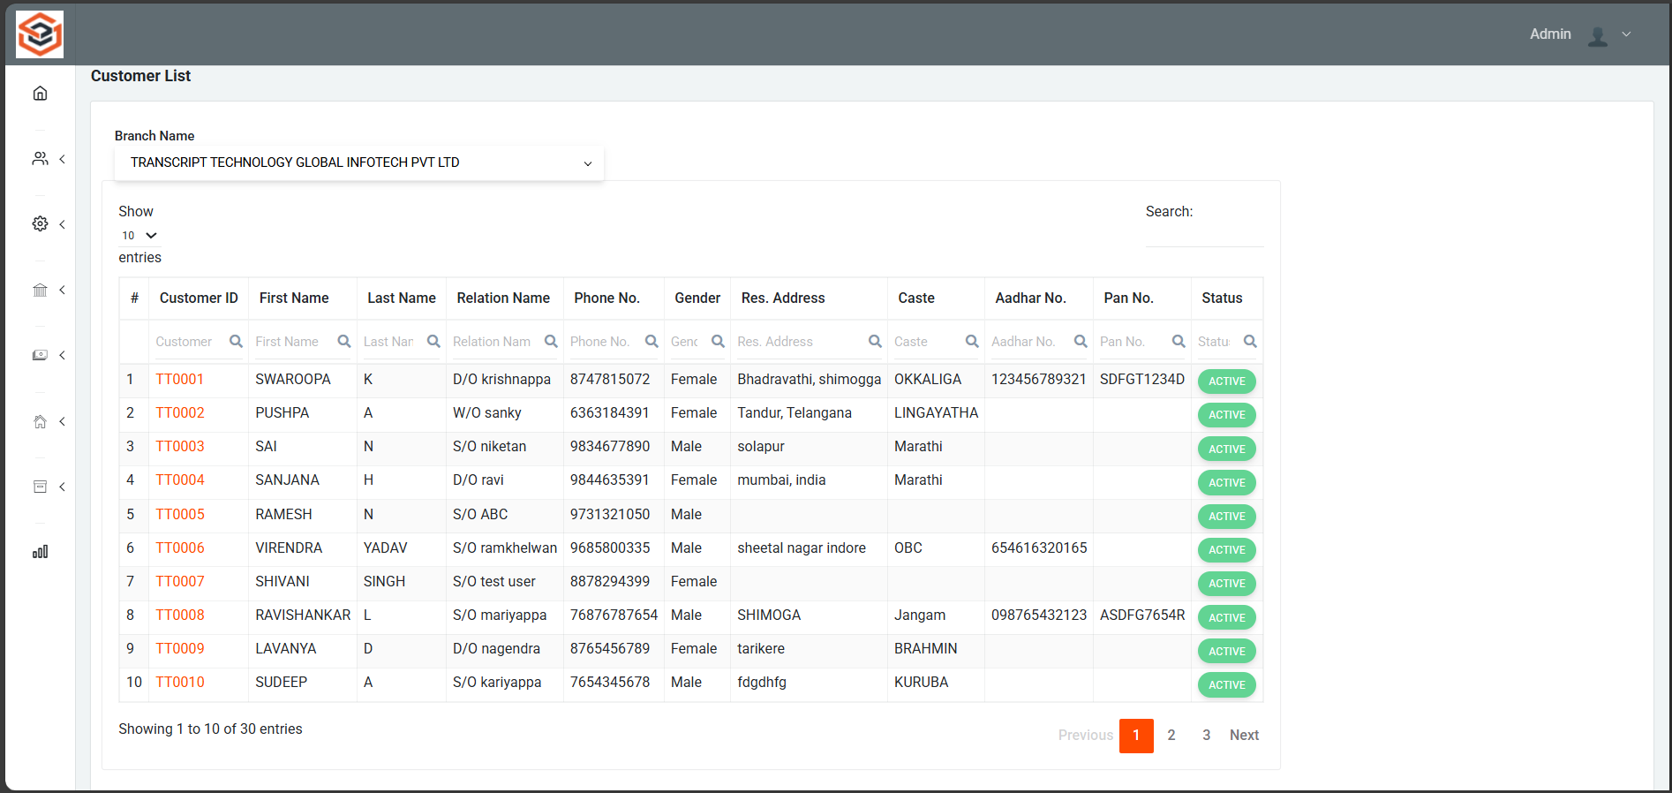
Customer list page

Slide 9
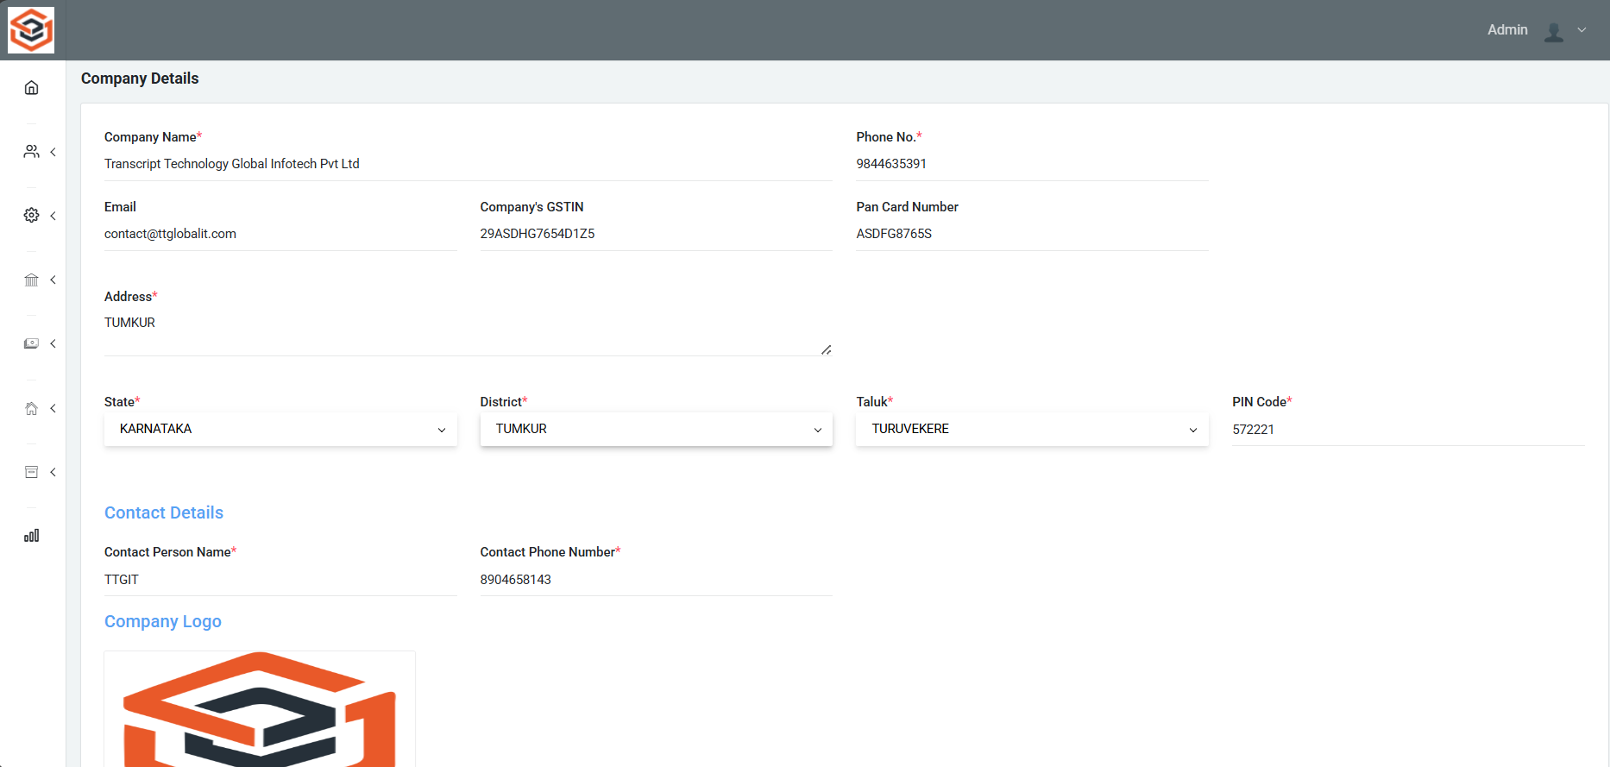
Company Details

Slide 10
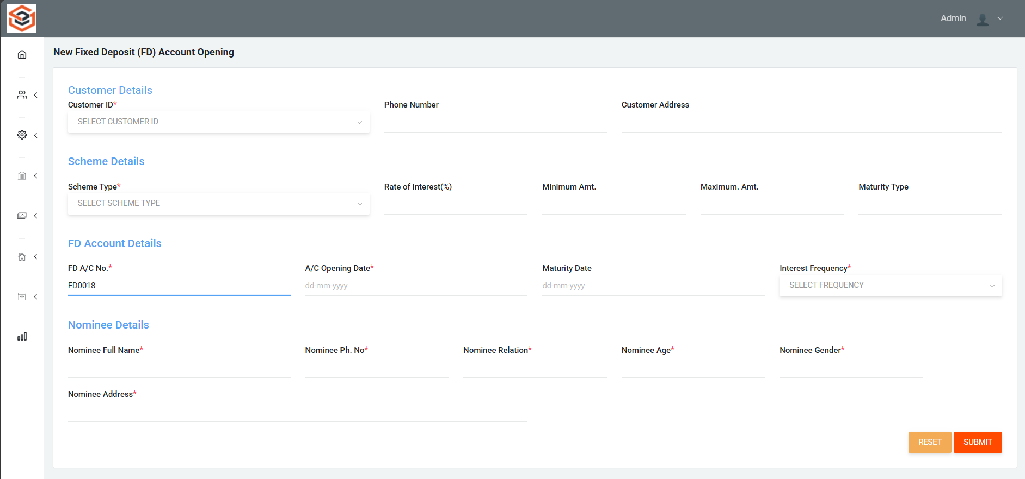
FD Account opening page

Slide 11
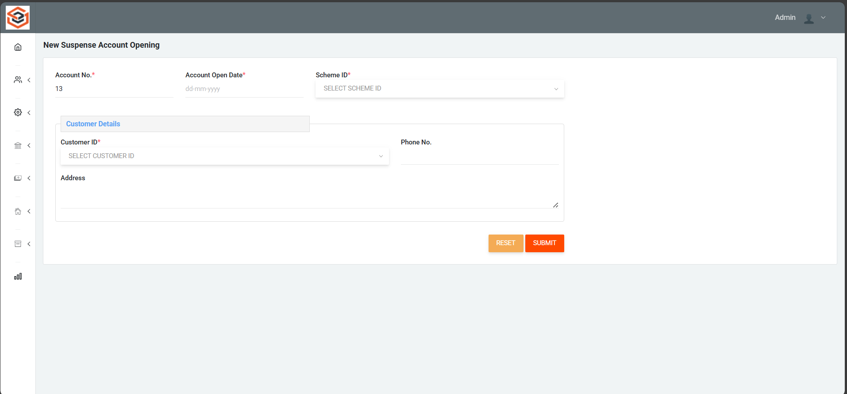
Suspense Account opening page

Slide 12
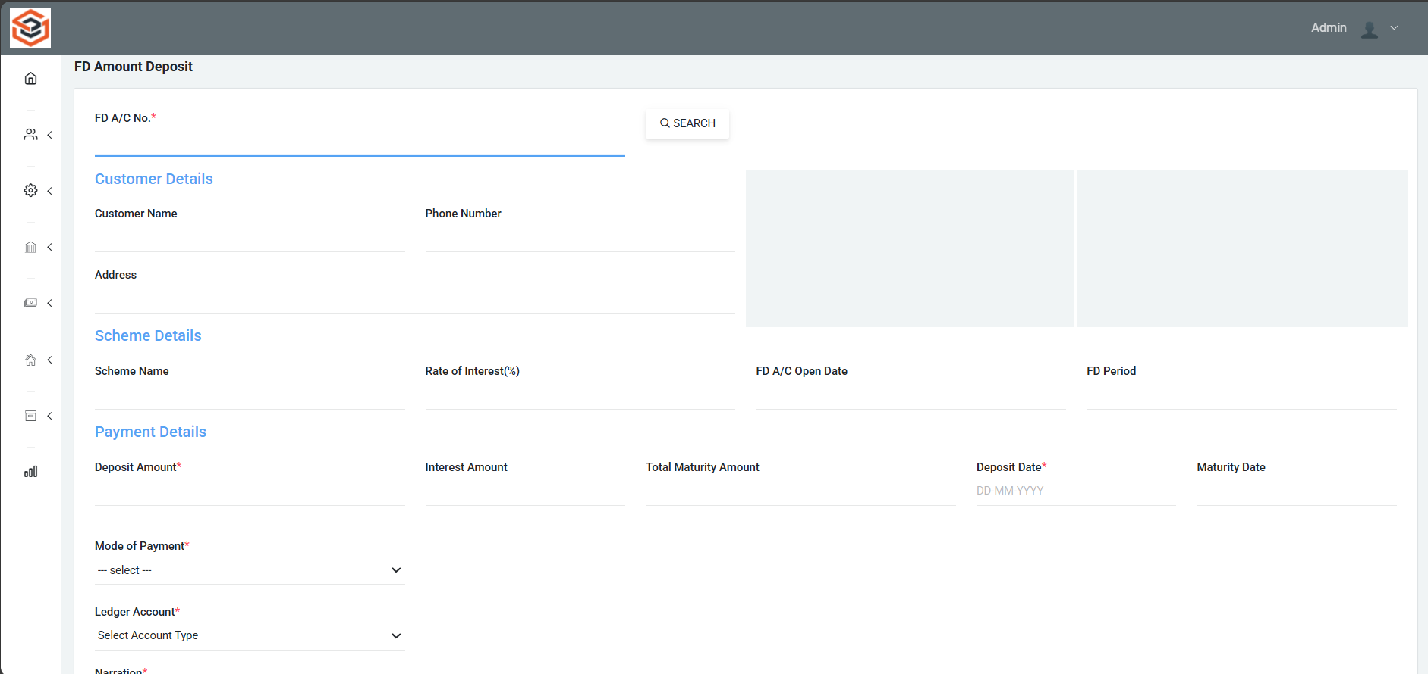
FD Amount Deposit

Slide 13
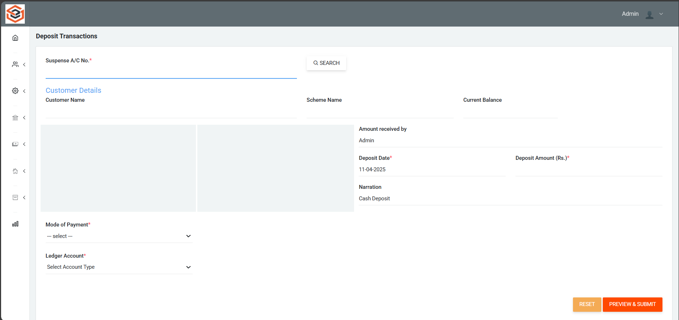
FD Deposit Transactions page

Slide 14
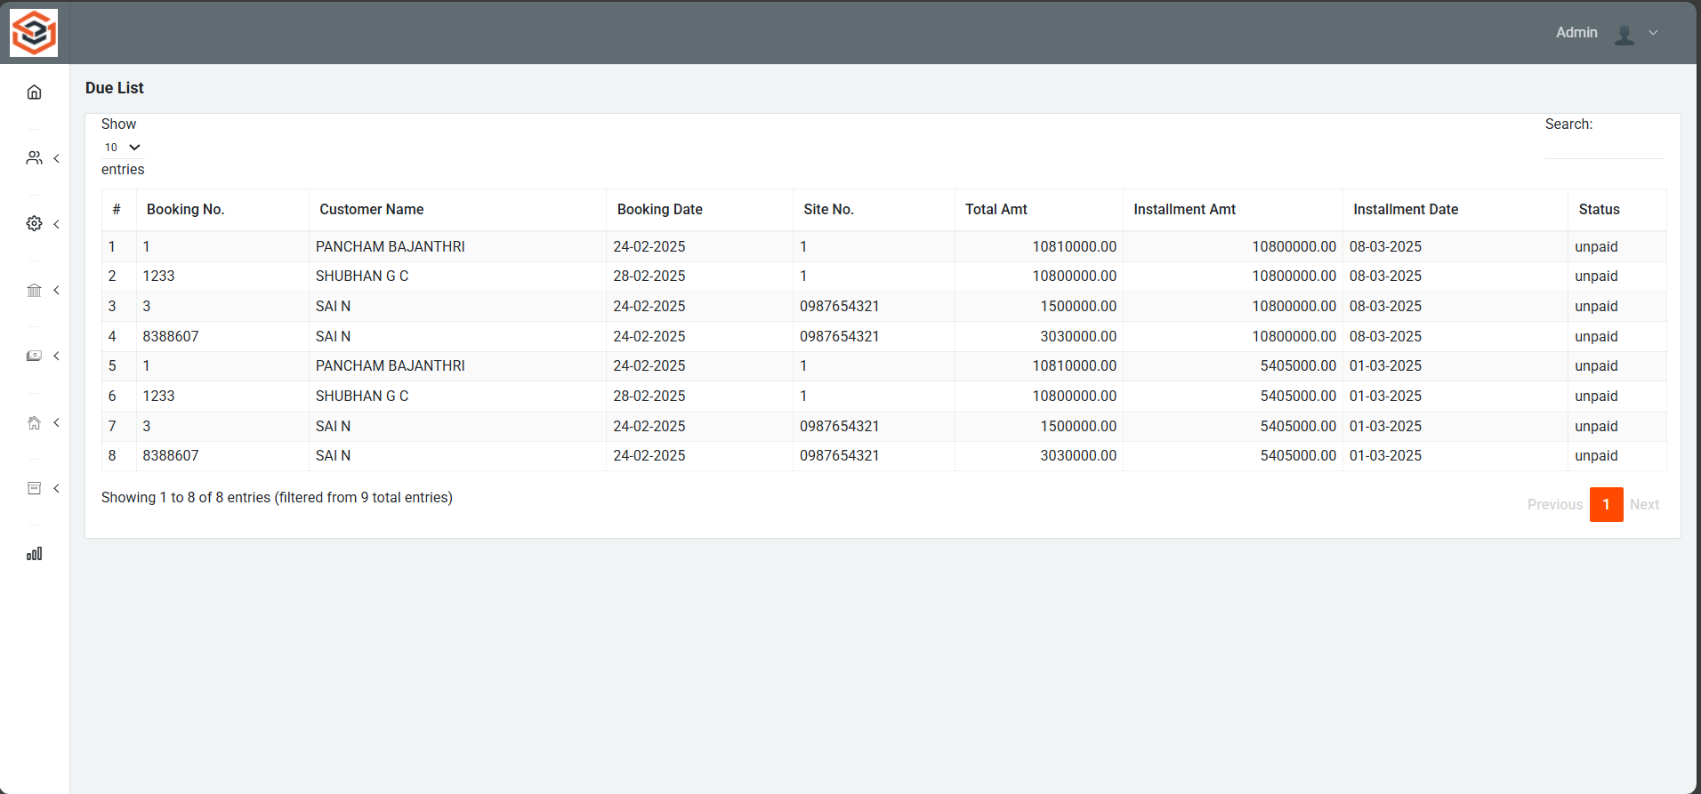
Loan Due List page

Slide 15
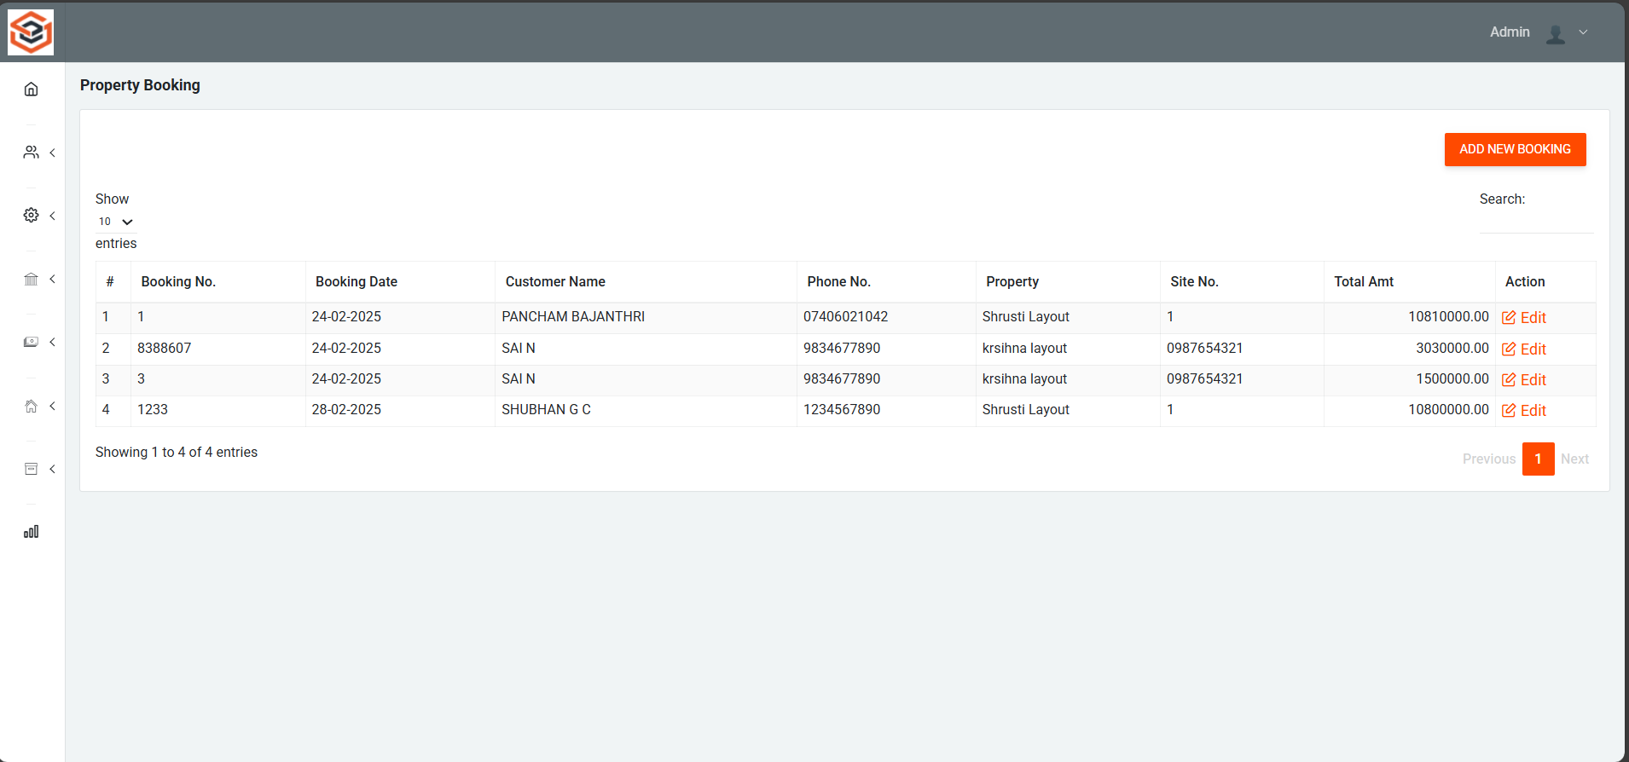
Property Booking Page

Slide 16
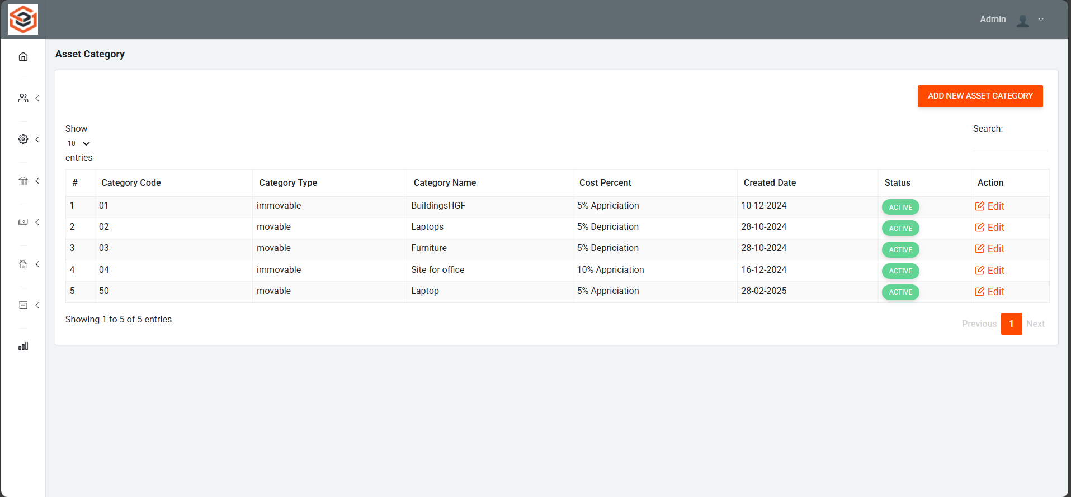
Asset Category List

Slide 17
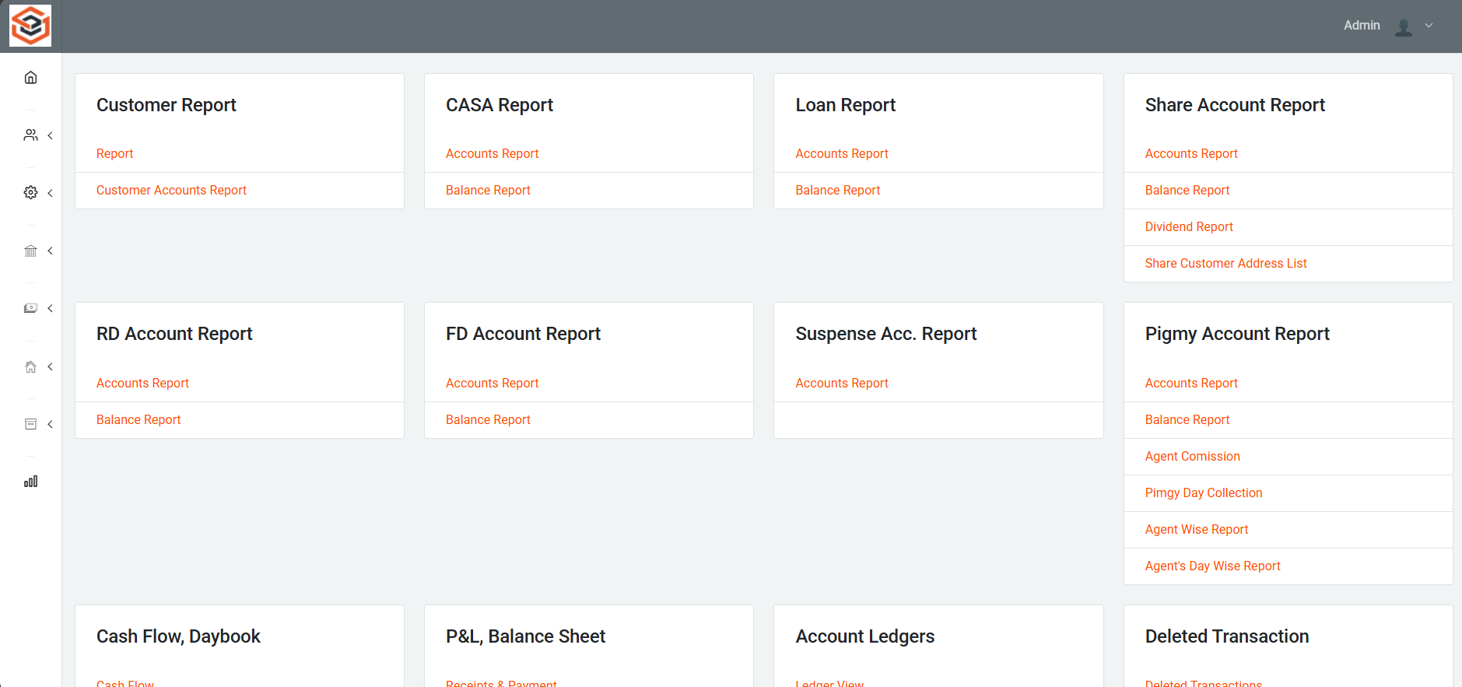
Reports Page

Slide 18
References
Digitalisation and Digital Transformation in the Social Economy: The Cases of Anecoop and Consum https://www.emerald.com/insight/content/doi/10.1108/BFJ-12-2022-1086/full/html
Digital Transformation in Indian Co-operative Banks https://www.tannum.io/2024/08/26/digital-transformation-in-indian-co-operative-banks/
Digital Transition of Cooperatives in the COVID-19 Era https://www.ijafame.org/index.php/ijafame/article/view/1324
Digital Transformation and Financial Performance of Deposit-Taking Savings and Credit Co-Operatives in Nairobi City County, Kenya https://edinburgjournals.org/journals/index.php/journal-of-finance-and-accountin/article/view/172

Slide 19


